Slide 1
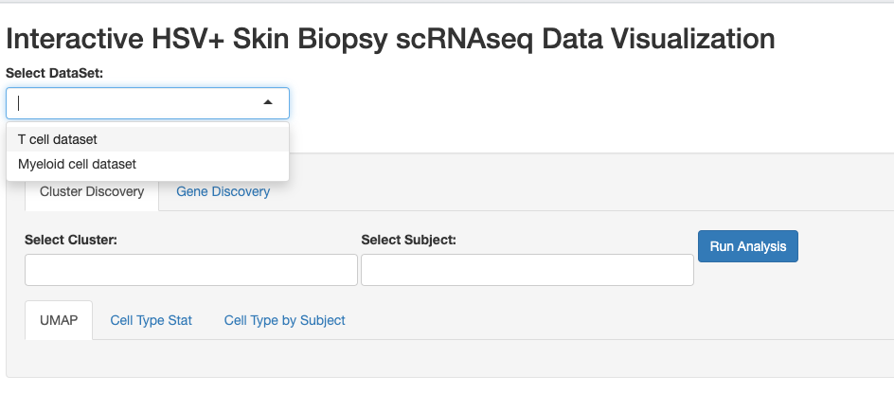
Various datasets selection
Cell Type for Status, and Subject
Gene Feature for Cell Type, Status, and Subject

Slide 2
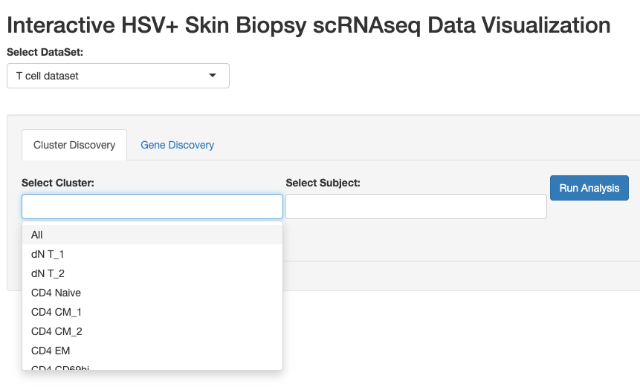
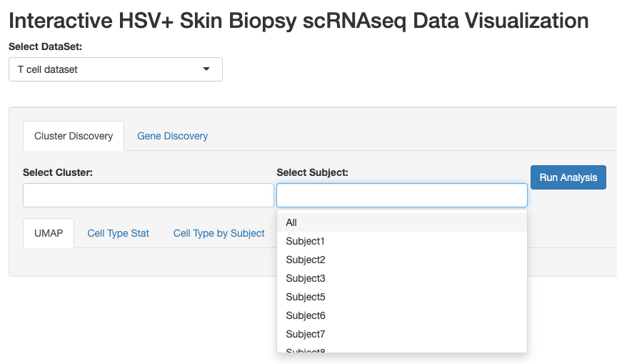
Select Cell Type
Select Subject

Slide 3
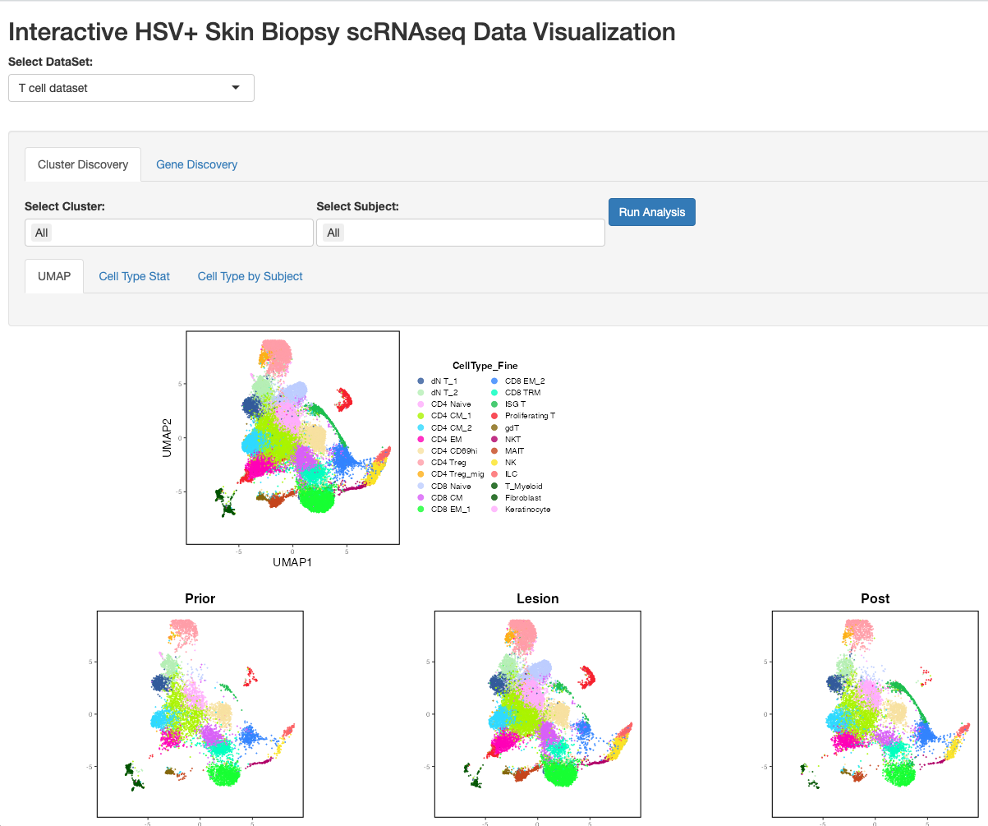

Slide 4
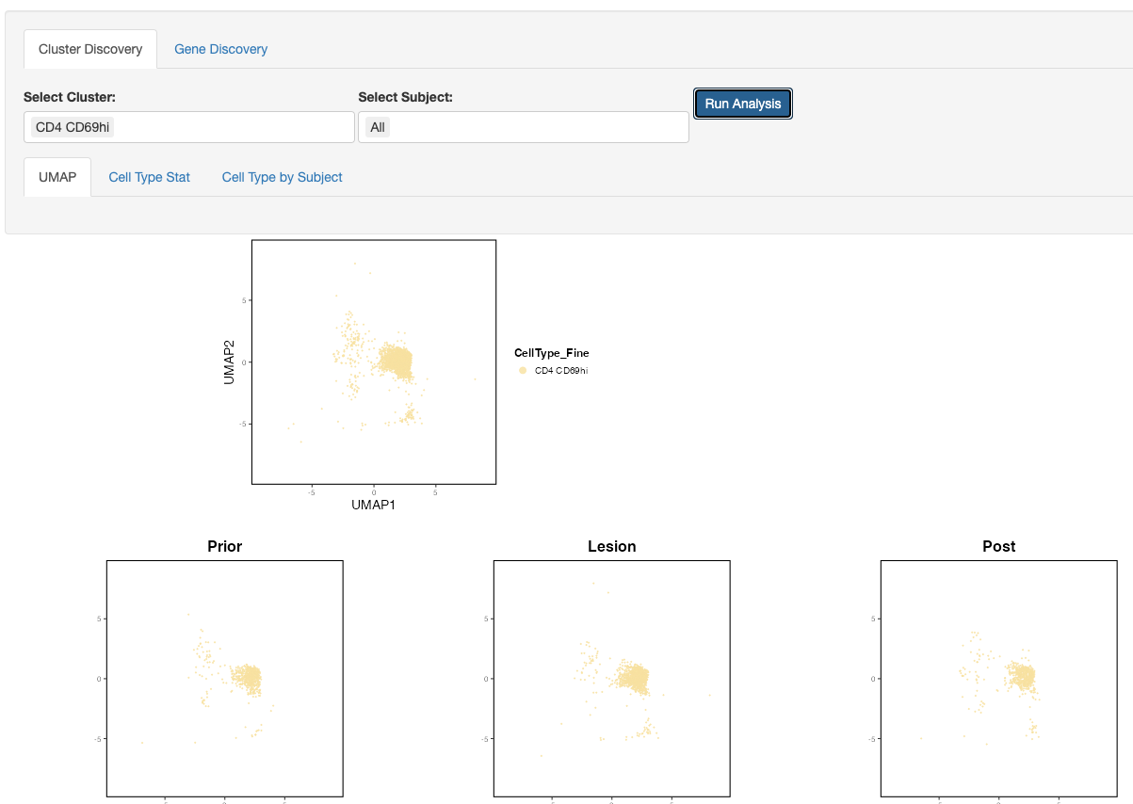
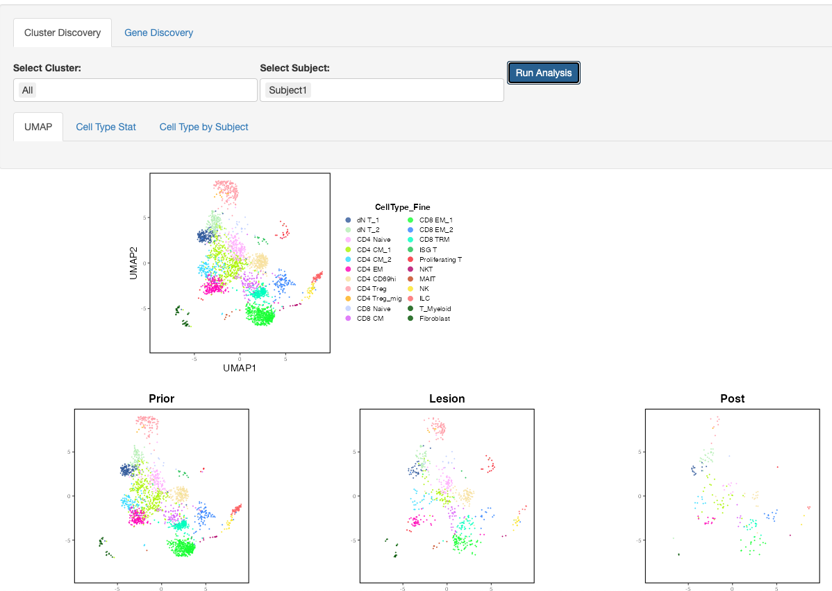
Specify Cluster
Specify Subject

Slide 5
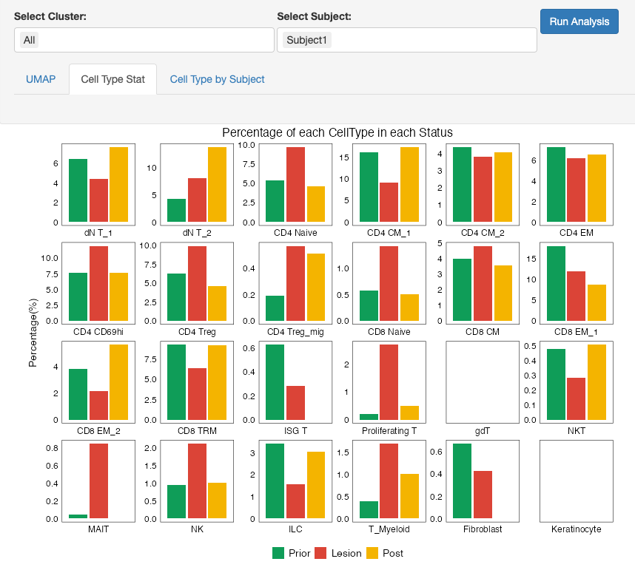
Cell Type% bar plot across status/time point synchronize with
Subject selection

Slide 6
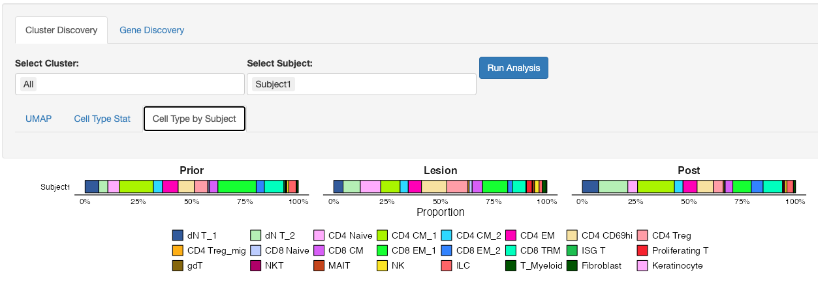
Stack bar plot shows Cell Type% within given sample (subject and status)

Slide 7
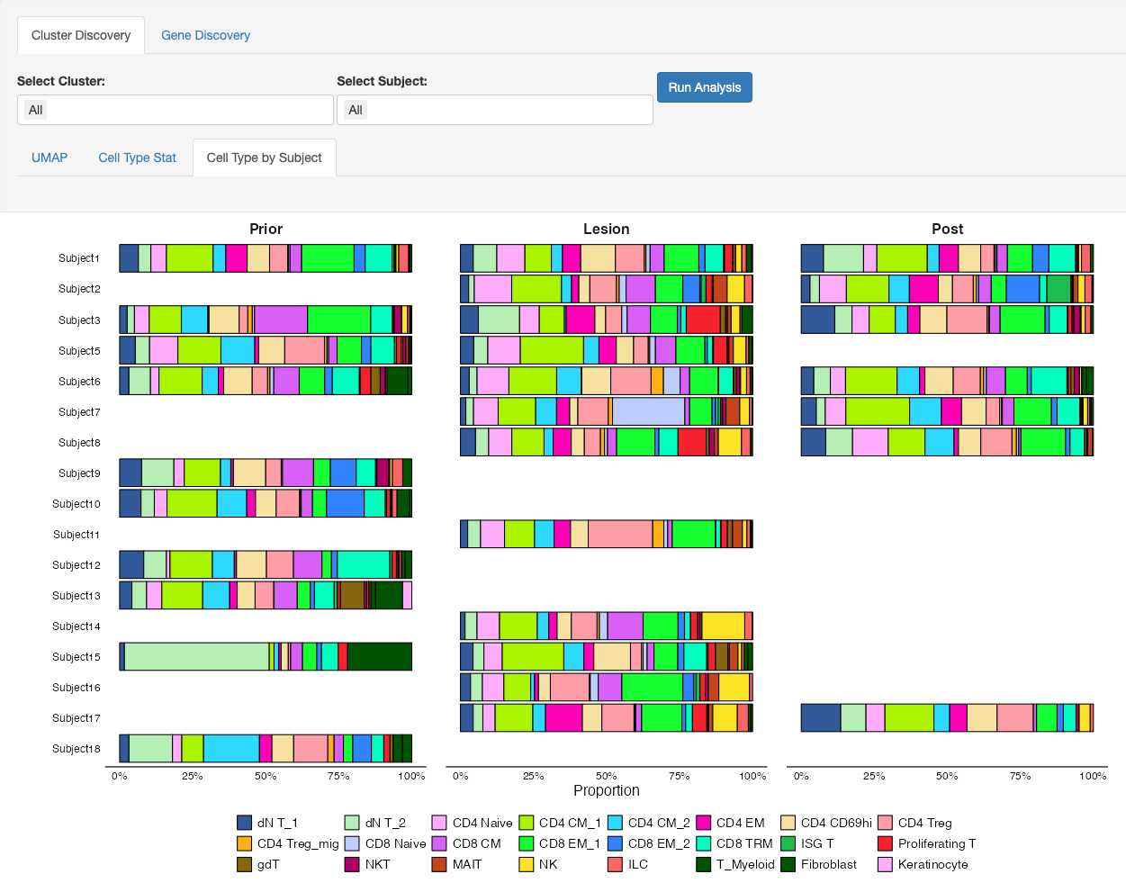
Or show all Subjects

Slide 8
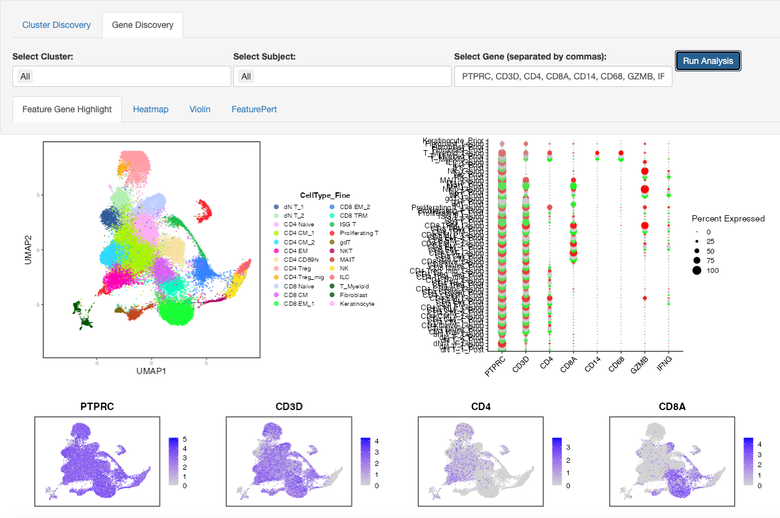

Slide 9
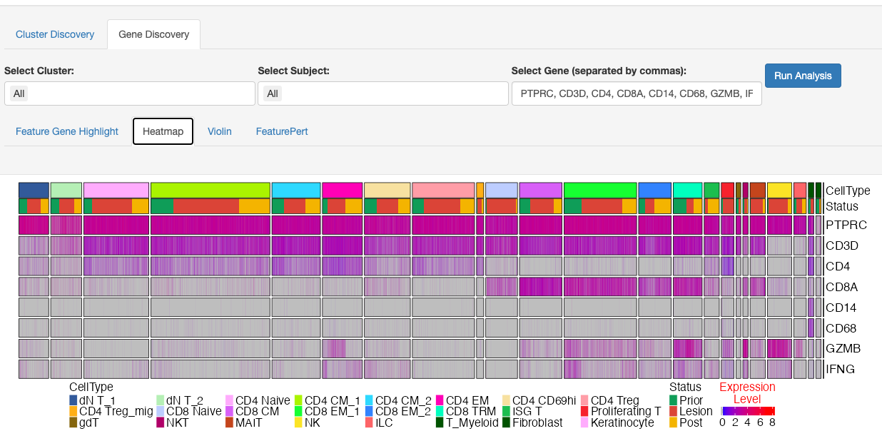

Slide 10
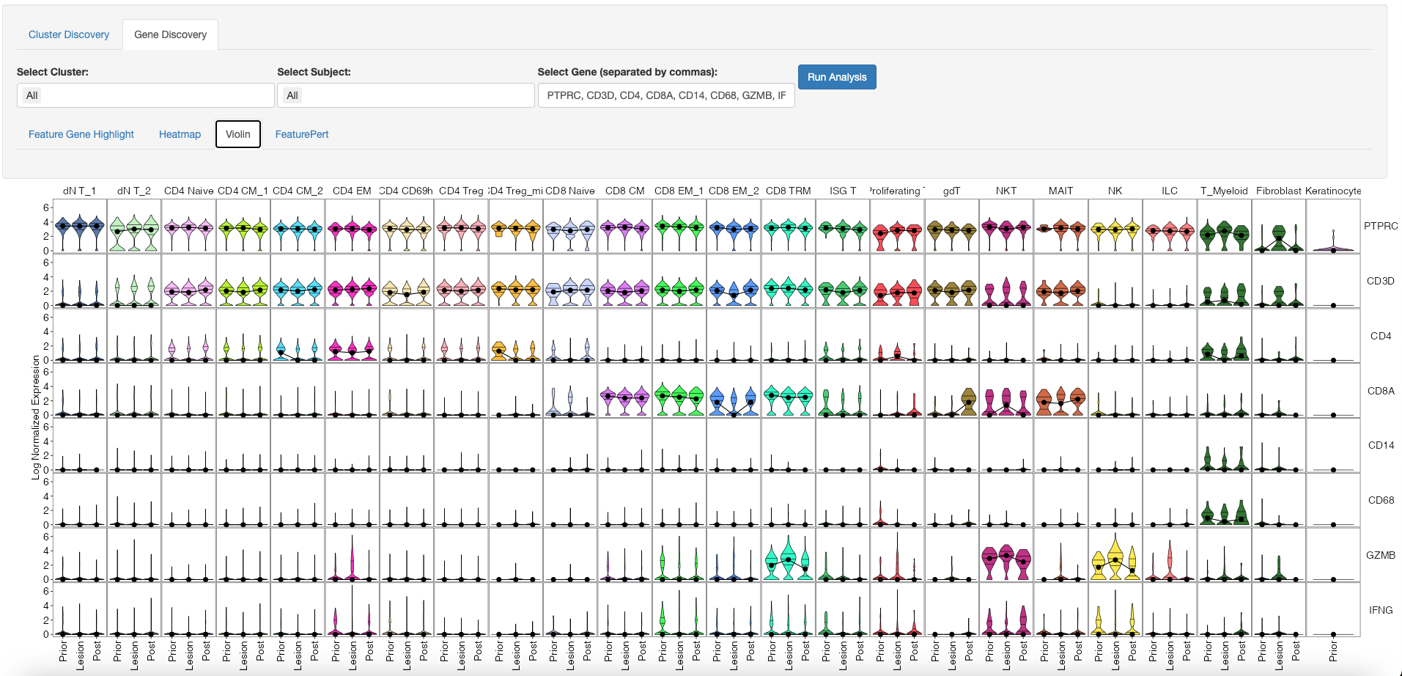

Slide 11
